Slide 1
Origins of the Chinese Empire
Ancient China
Shang Dynasty
Zhou Dynasty

Slide 2
Ancient China
Regionalism
  Huang He, Yellow River
    Longshan
Philosophy
  Tian
  Yijing
  Yin and Yang: Cosmic Forces
    Yin = dark, wet, soft, earth, moon, and feminine
    Yang = light, dry, hard, heaven, sun, and masculine

Slide 3
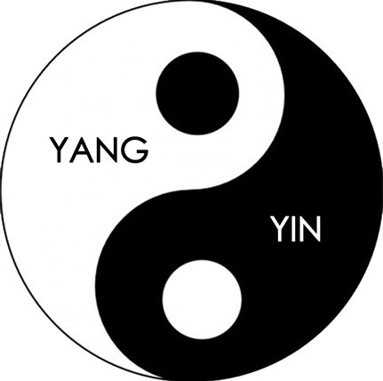
Cosmic Forces

Slide 4
Shang Dynasty (1766-1122 B.C.E)
  Authoritarian State
    Military Supremacy
      King Wu Ding
        Military Chieftain
    Social Hierarchy
      Landowning Aristocrats (Nobility)
  Cultural Development
    Writing System

Slide 5
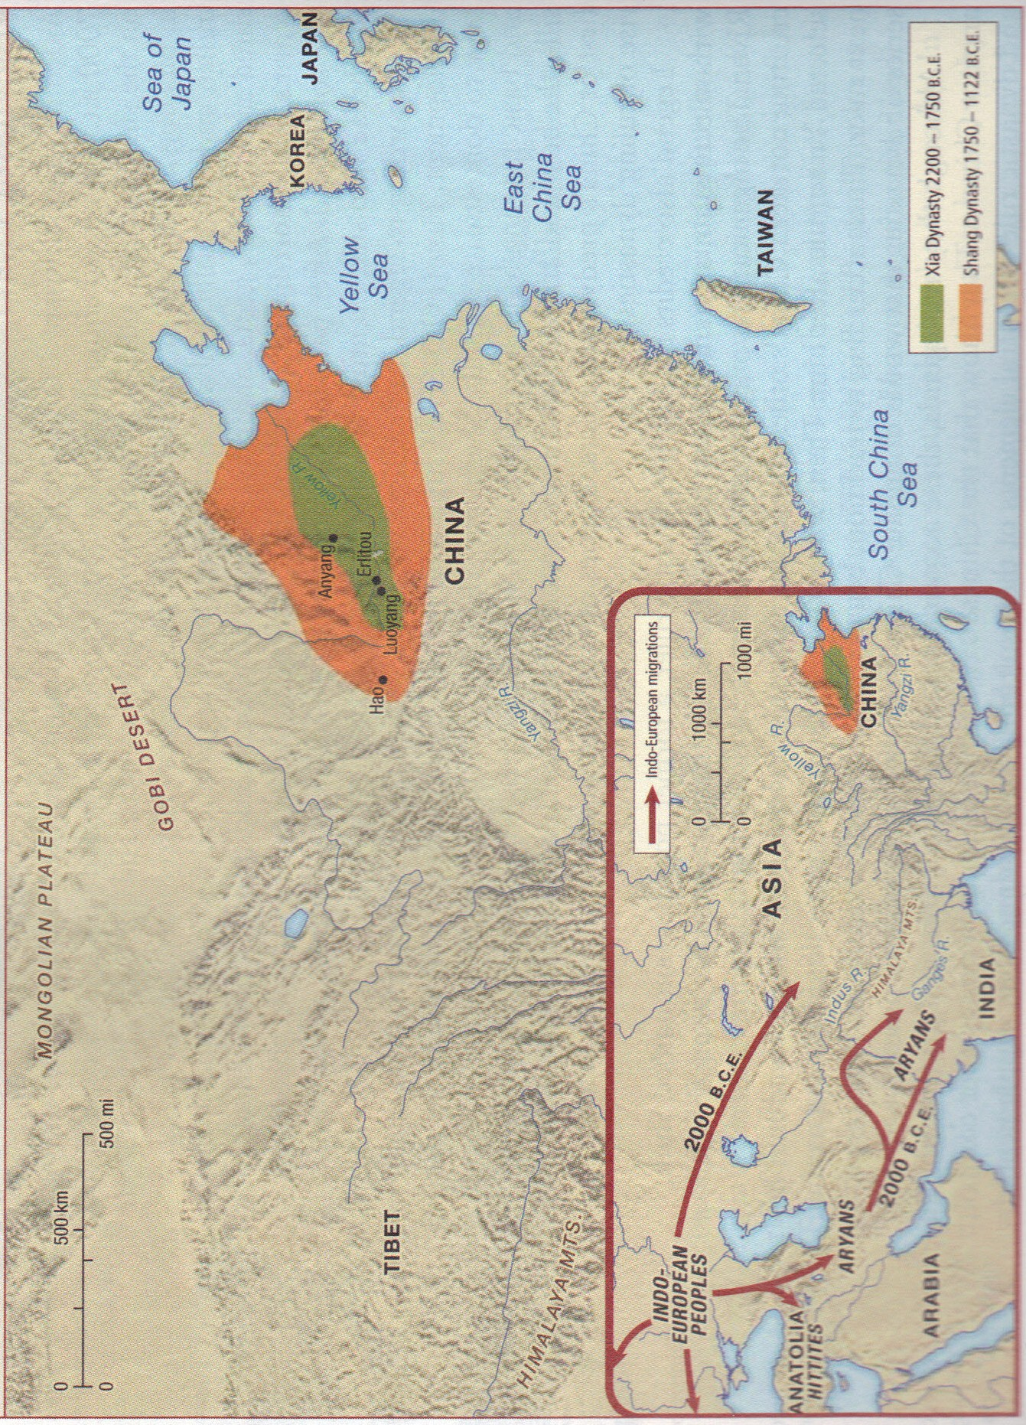

Slide 6
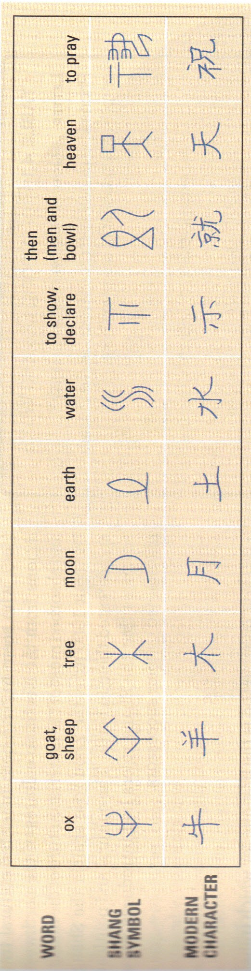
Writing

Slide 7
Zhou Dynasty (1122-481 B.C.E.)
  Feudalism
    Weak central government
      King
      Aristocrat (Vassal) – also known as Nobility
        Military leaders or civil servants – Shi
        Peasants
          Bound to the Vassal
  Mandate of Heaven
  Dynastic Cycle
  Development of a Writing System

Slide 8
